Slide 1
Splay Trees
6
v
3
8
z
4
Splay Trees
Notes:
Red-Black Trees

Slide 2
Splay Trees are Binary Search Trees
(20,Z)
all the keys in the blue region are ≥ 20
note that two keys of equal value may be well-separated
(10,A)
(35,R)
BST Rules:
  entries stored only at internal nodes
  keys stored at nodes in the left subtree of v are less than or equal to the key stored at v
  keys stored at nodes in the right subtree of v are greater than or equal to the key stored at v
An inorder traversal will return the keys in order
(7,T)
(14,J)
(21,O)
(37,P)
(1,Q)
(8,N)
(36,L)
(40,X)
(1,C)
(5,H)
(7,P)
(10,U)
(2,R)
(5,G)
all the keys in the yellow region are ≤ 20
(5,I)
(6,Y)
Splay Trees

Slide 3
Searching in a Splay Tree:
Starts the Same as in a BST
(20,Z)
Search proceeds down the tree to found item or an external node.
Example: Search for time with key 11.
(10,A)
(35,R)
(7,T)
(14,J)
(21,O)
(37,P)
(1,Q)
(8,N)
(36,L)
(40,X)
(1,C)
(5,H)
(7,P)
(10,U)
(2,R)
(5,G)
(5,I)
(6,Y)
Splay Trees

Slide 4
Example Searching in a BST, continued
(20,Z)
search for key 8, ends at an internal node.
(10,A)
(35,R)
(7,T)
(14,J)
(21,O)
(37,P)
(1,Q)
(8,N)
(36,L)
(40,X)
(1,C)
(5,H)
(7,P)
(10,U)
(2,R)
(5,G)
(5,I)
(6,Y)
Splay Trees

Slide 5
Splay Trees do Rotations after Every Operation (Even Search)
new operation: splay
  splaying moves a node to the root using rotations
right rotation
  makes the left child x of a node y into y’s parent; y becomes the right child of x
left rotation
  makes the right child y of a node x into x’s parent; x becomes the left child of y
y
x
a right rotation about y
a left rotation about x
x
T₃
T₁
y
x
y
T₁
T₂
T₁
T₂
T₃
y
x
T₃
T₂
T₃
T₁
T₂
(structure of tree above y is not modified)
(structure of tree above x is not modified)
Splay Trees

Slide 6
Splaying:
“x is a left-left grandchild” means x is a left child of its parent, which is itself a left child of its parent
p is x’s parent; g is p’s parent
start with node x
is x a left-left grandchild?
is x the root?
yes
zig-zig
stop
yes
right-rotate about g, right-rotate about p
no
is x a right-right grandchild?
is x a child of the root?
zig-zig
no
yes
left-rotate about g, left-rotate about p
yes
is x a right-left grandchild?
is x the left child of the root?
zig-zag
no
yes
left-rotate about p, right-rotate about g
is x a left-right grandchild?
zig
zig
zig-zag
yes
right-rotate about the root
left-rotate about the root
yes
right-rotate about p, left-rotate about g
Splay Trees

Slide 7
Visualizing the Splaying Cases
zig-zag
x
z
z
T₄
y
z
y
T₁
y
T₄
T₁
T₂
T₃
T₄
T₃
x
x
T₂
T₃
T₁
T₂
zig-zig
x
y
zig
T₁
T₄
x
y
x
T₂
T₃
w
y
z
w
T₃
T₄
T₁
T₂
T₃
T₄
T₁
T₂
Splay Trees

Slide 8
Splaying Example
(20,Z)
(10,A)
(35,R)
let x = (8,N)
  x is the right child of its parent, which is the left child of the grandparent
  left-rotate around p, then right-rotate around g
g
1.
(before rotating)
p
(7,T)
(14,J)
(21,O)
(37,P)
(1,Q)
(8,N)
(36,L)
(40,X)
x
(1,C)
(5,H)
(7,P)
(10,U)
(2,R)
(5,G)
(20,Z)
(5,I)
(6,Y)
g
(10,A)
(35,R)
(20,Z)
x
(8,N)
(14,J)
(21,O)
(37,P)
x
(8,N)
(35,R)
g
p
(7,T)
(10,U)
(36,L)
(40,X)
p
(7,T)
(10,A)
(21,O)
(37,P)
(1,Q)
(7,P)
(1,Q)
(7,P)
(14,J)
(36,L)
(40,X)
2.
(after first rotation)
(1,C)
(5,H)
(1,C)
(5,H)
(10,U)
3.
(after second rotation)
(2,R)
(5,G)
(2,R)
(5,G)
(5,I)
(6,Y)
(5,I)
(6,Y)
x is not yet the root, so we splay again
Splay Trees

Slide 9
Splaying Example, Continued
now x is the left child of the root
  right-rotate around root
(20,Z)
x
(8,N)
(35,R)
(7,T)
(10,A)
(21,O)
(37,P)
(1,Q)
(7,P)
(14,J)
(36,L)
(40,X)
(8,N)
x
2.
(after rotation)
(1,C)
(5,H)
(10,U)
1.
(before applying rotation)
(7,T)
(20,Z)
(2,R)
(5,G)
(1,Q)
(7,P)
(10,A)
(35,R)
(5,I)
(6,Y)
(1,C)
(5,H)
(14,J)
(21,O)
(37,P)
(2,R)
(5,G)
(10,U)
(36,L)
(40,X)
(5,I)
(6,Y)
Splay Trees
x is the root, so stop

Slide 10
Example Result of Splaying
(20,Z)
(10,A)
(35,R)
before
(7,T)
(14,J)
(21,O)
(37,P)
tree might not be more balanced
e.g. splay (40,X)
  before, the depth of the shallowest leaf is 3 and the deepest is 7
  after, the depth of shallowest leaf is 1 and deepest is 8
(1,Q)
(8,N)
(36,L)
(40,X)
(1,C)
(5,H)
(7,P)
(10,U)
(2,R)
(5,G)
(40,X)
(5,I)
(6,Y)
(20,Z)
(20,Z)
(10,A)
(40,X)
(10,A)
(37,P)
(14,J)
(37,P)
(7,T)
(14,J)
(35,R)
(7,T)
(1,Q)
(8,N)
(35,R)
(1,Q)
(8,N)
(21,O)
(36,L)
(1,C)
(10,U)
(21,O)
(36,L)
(1,C)
(5,H)
(7,P)
(10,U)
(5,H)
(7,P)
(2,R)
(5,G)
(2,R)
(5,G)
after first splay
after second splay
(6,Y)
(5,I)
(6,Y)
(5,I)
Splay Trees

Slide 11

Splay Tree Definition
a splay tree is a binary search tree where a node is splayed after it is accessed (for a search or update)
  deepest internal node accessed is splayed
  splaying costs O(h), where h is height of the tree – which is still O(n) worst-case
    O(h) rotations, each of which is O(1)
Splay Trees

Slide 12

Splay Trees & Ordered Dictionaries
which nodes are splayed after each operation?
method
splay node
if key found, use that node
if key not found, use parent of ending external node
Search for k
Insert (k,v)
use the new node containing the entry inserted
use the parent of the internal node that was actually removed from the tree (the parent of the node that the removed item was swapped with)
Remove item with key k
Splay Trees

Slide 13
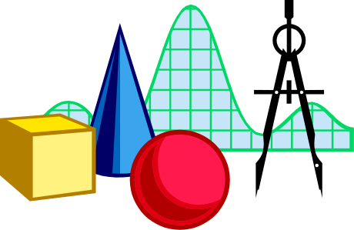
Amortized Analysis of Splay Trees
Running time of each operation is proportional to time for splaying.
Define rank(v) as the logarithm (base 2) of the number of nodes in subtree rooted at v.
Costs: zig = $1, zig-zig = $2, zig-zag = $2.
Thus, cost for playing a node at depth d = $d.
Imagine that we store rank(v) cyber-dollars at each node v of the splay tree (just for the sake of analysis).
Splay Trees

Slide 14

Cost per zig
y
zig
T₄
x
x
T₃
w
y
w
T₁
T₂
T₃
T₄
T₁
T₂
Doing a zig at x costs at most rank’(x) - rank(x):
  cost = rank’(x) + rank’(y) - rank(y) - rank(x) < rank’(x) - rank(x).
Splay Trees

Slide 15
Cost per zig-zig and zig-zag
z
T₄
T₁
x
y
T₃
zig-zig
y
T₂
T₁
x
T₂
z
T₃
T₄
Doing a zig-zig or zig-zag at x costs at most 3(rank’(x) - rank(x)) - 2
z
zig-zag
x
T₁
y
z
y
T₄
T₁
T₂
T₃
T₄
x
T₂
T₃
Splay Trees

Slide 16
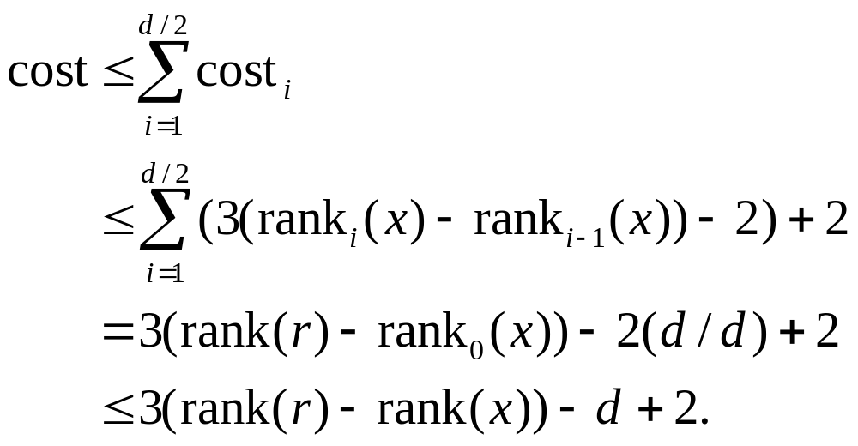
Cost of Splaying
Cost of splaying a node x at depth d of a tree rooted at r:
  at most 3(rank(r) - rank(x)) - d + 2:
  Proof: Splaying x takes d/2 splaying substeps:
Splay Trees

Slide 17

Performance of Splay Trees
Recall: rank of a node is logarithm of its size.
Thus, amortized cost of any splay operation is O(log n)
In fact, the analysis goes through for any reasonable definition of rank(x)
This implies that splay trees can actually adapt to perform searches on frequently-requested items much faster than O(log n) in some cases
Splay Trees

Slide 18
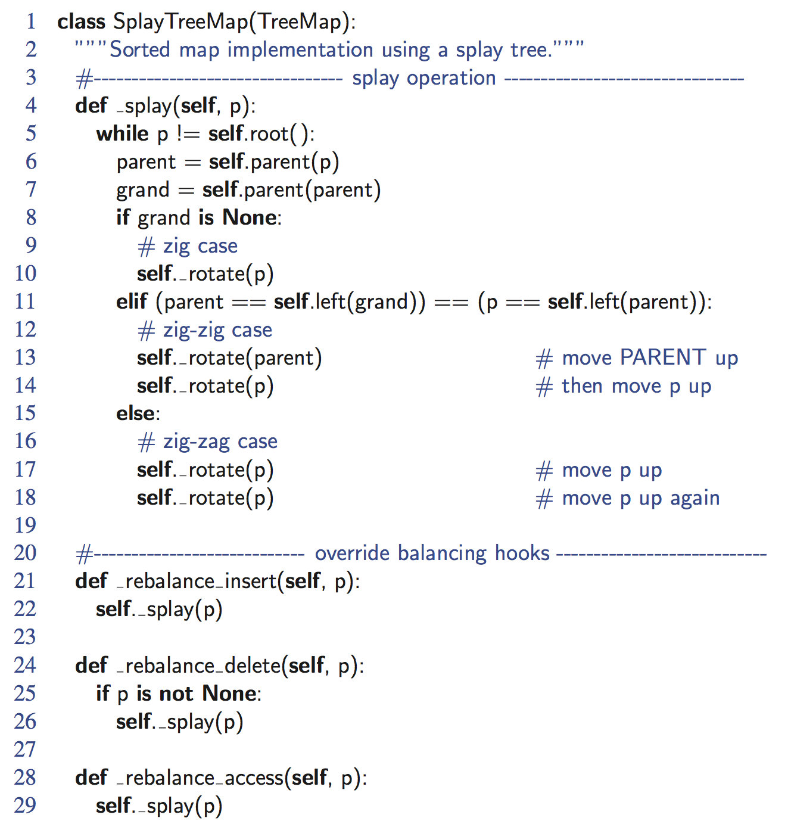
Python Implementation
Splay Trees

